Slide 1
JavaScript
Dr. Sandeep Kumar Satapathy

Slide 2
What is JavaScript
JavaScript (js) is a light-weight object-oriented programming language which is used by several websites for scripting the webpages.
It is an interpreted, full-fledged programming language that enables dynamic interactivity on websites when applied to an HTML document.
It was introduced in the year 1995 for adding programs to the webpages in the Netscape Navigator browser.

Slide 3
What is JavaScript
Since then, it has been adopted by all other graphical web browsers.
With JavaScript, users can build modern web applications to interact directly without reloading the page every time.
The traditional website uses js to provide several forms of interactivity and simplicity.
Although, JavaScript has no connectivity with Java programming language. The name was suggested and provided in the times when Java was gaining popularity in the market.
In addition to web browsers, databases such as CouchDB and MongoDB uses JavaScript as their scripting and query language.

Slide 4
Features of JavaScript
All popular web browsers support JavaScript as they provide built-in execution environments.
JavaScript follows the syntax and structure of the C programming language. Thus, it is a structured programming language.
JavaScript is a weakly typed language, where certain types are implicitly cast (depending on the operation).
JavaScript is an object-oriented programming language that uses prototypes rather than using classes for inheritance.

Slide 5
Features of JavaScript
It is a light-weighted and interpreted language.
It is a case-sensitive language.
JavaScript is supportable in several operating systems including, Windows, macOS, etc.
It provides good control to the users over the web browsers.

Slide 6
Application of JavaScript
JavaScript is used to create interactive websites. It is mainly used for:
Client-side validation,
Dynamic drop-down menus,
Displaying date and time,
Displaying pop-up windows and dialog boxes (like an alert dialog box, confirm dialog box and prompt dialog box),
Displaying clocks etc.

Slide 7
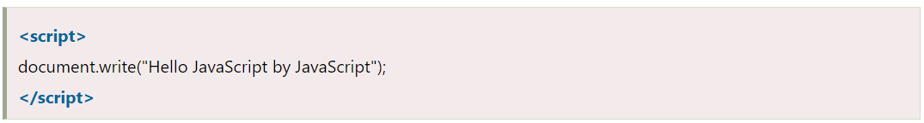
JavaScript Example

Slide 8
JavaScript Variable
A JavaScript variable is simply a name of storage location. There are two types of variables in JavaScript : local variable and global variable.
There are some rules while declaring a JavaScript variable (also known as identifiers).
Name must start with a letter (a to z or A to Z), underscore( _ ), or dollar( $ ) sign.
After first letter we can use digits (0 to 9), for example value1.
JavaScript variables are case sensitive, for example x and X are different variables.

Slide 9
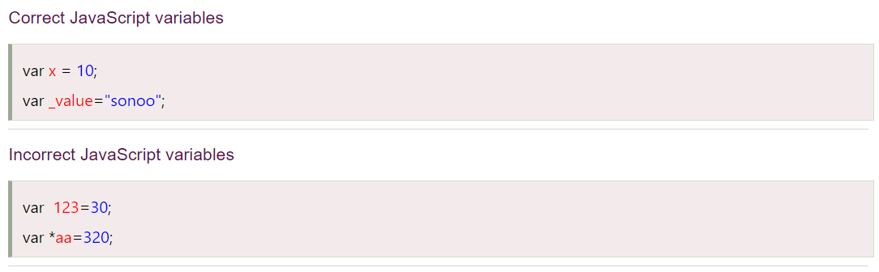
JavaScript Variables

Slide 10
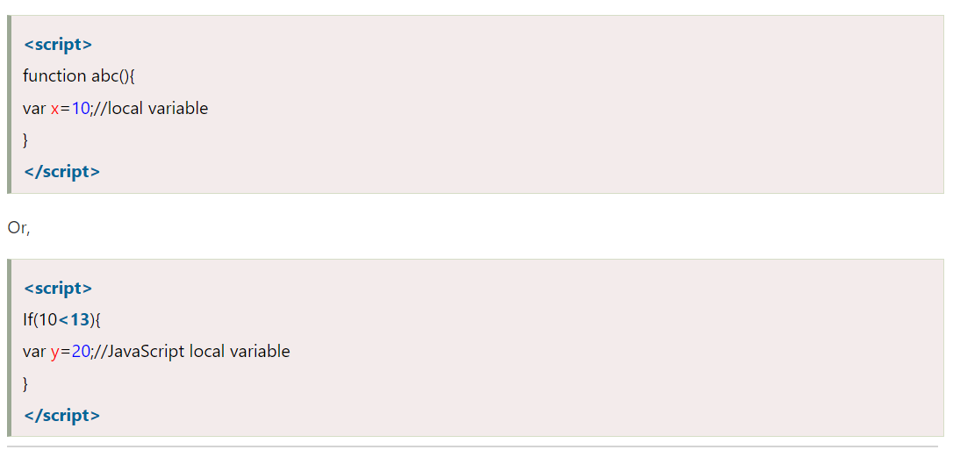
JavaScript Local Variables

Slide 11
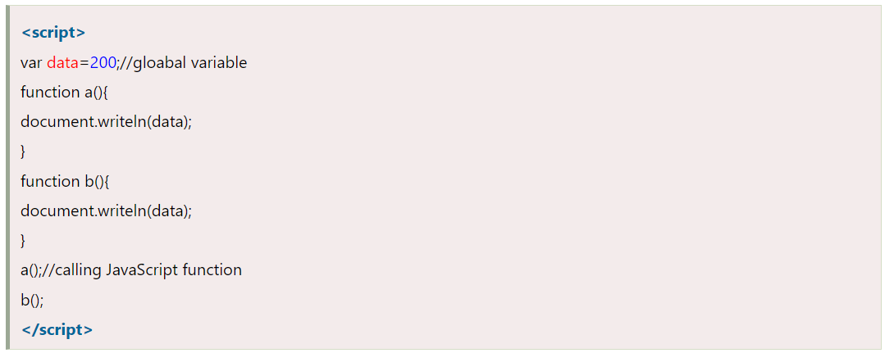
JavaScript Global Variables

Slide 12
JavaScript Data Types
JavaScript provides different data types to hold different types of values. There are two types of data types in JavaScript.
Primitive data type
Non-primitive (reference) data type
JavaScript is a dynamic type language, means you don't need to specify type of the variable because it is dynamically used by JavaScript engine.
You need to use var here to specify the data type. It can hold any type of values such as numbers, strings etc.
var a=40;//holding number
var b="Rahul";//holding string

Slide 13
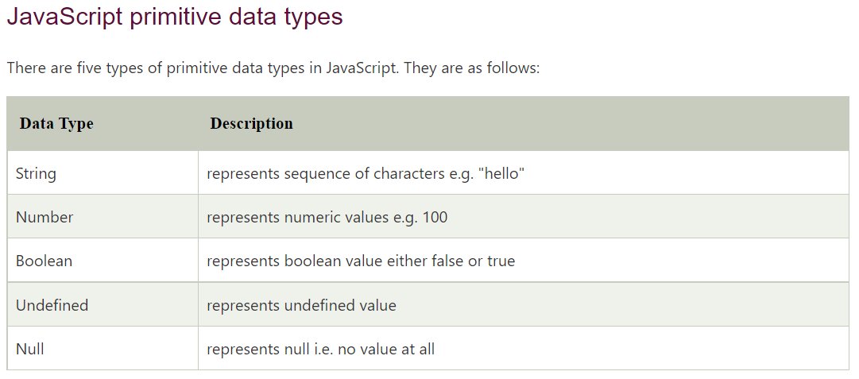
JavaScript Data Types

Slide 14
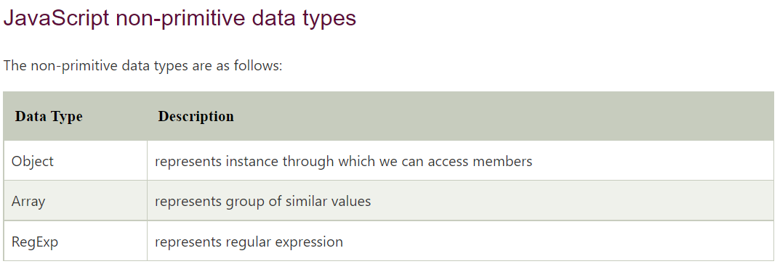
JavaScript Data Types

Slide 15
JavaScript Operators
JavaScript operators are symbols that are used to perform operations on operands.
For example: var sum=10+20;
Here, + is the arithmetic operator and = is the assignment operator.
There are following types of operators in JavaScript.
Arithmetic Operators
Comparison (Relational) Operators
Bitwise Operators
Logical Operators
Assignment Operators
Special Operators

Slide 16
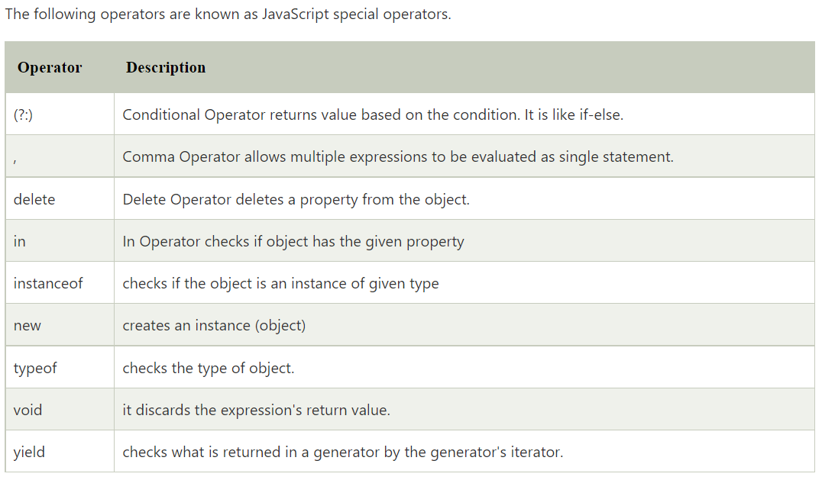
JavaScript Operators

Slide 17
JavaScript If-else
The JavaScript if-else statement is used to execute the code whether condition is true or false. There are three forms of if statement in JavaScript.
If Statement
If else statement
if else if statement
JavaScript If statement
It evaluates the content only if expression is true. The signature of JavaScript if statement is given below.
if(expression){
//content to be evaluated
}

Slide 18
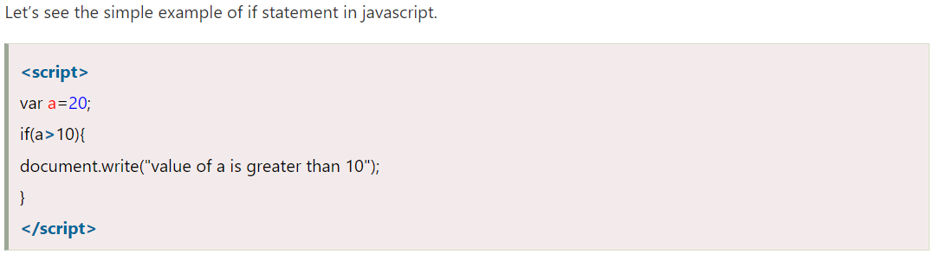
JavaScript If statement

Slide 19
JavaScript If...else Statement
It evaluates the content whether condition is true of false. The syntax of JavaScript if-else statement is given below.
if(expression){
//content to be evaluated if condition is true
}
else{
//content to be evaluated if condition is false
}

Slide 20
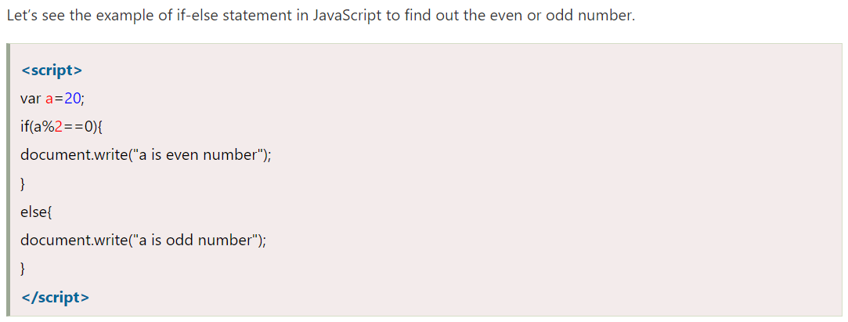
JavaScript If...else Statement

Slide 21
JavaScript If...else if statement
It evaluates the content only if expression is true from several expressions. The signature of JavaScript if else if statement is given below.
if(expression1){
//content to be evaluated if expression1 is true
}
else if(expression2){
//content to be evaluated if expression2 is true
}
else if(expression3){
//content to be evaluated if expression3 is true
}
else{
//content to be evaluated if no expression is true
}

Slide 22
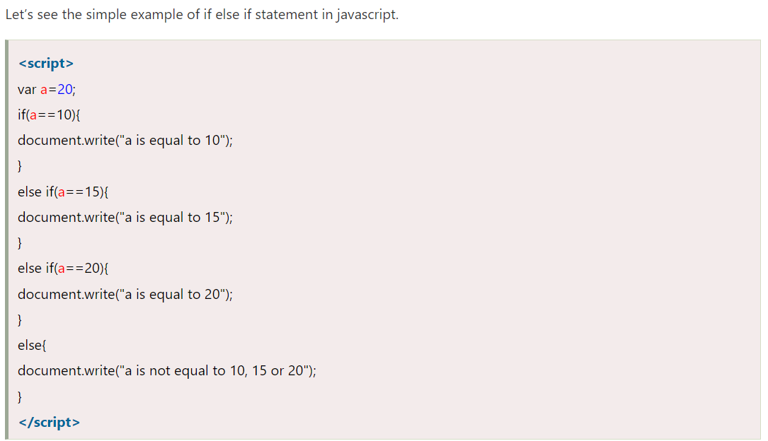
JavaScript If...else if statement

Slide 23
JavaScript Switch
The JavaScript switch statement is used to execute one code from multiple expressions.
It is just like else if statement that we have learned in previous page.
But it is convenient than if..else..if because it can be used with numbers, characters etc.
The signature of JavaScript switch statement is given below.

Slide 24
JavaScript Switch
switch(expression){
case value1:
code to be executed;
break;
case value2:
code to be executed;
break;
......
default:
code to be executed if above values are not matched;
}

Slide 25
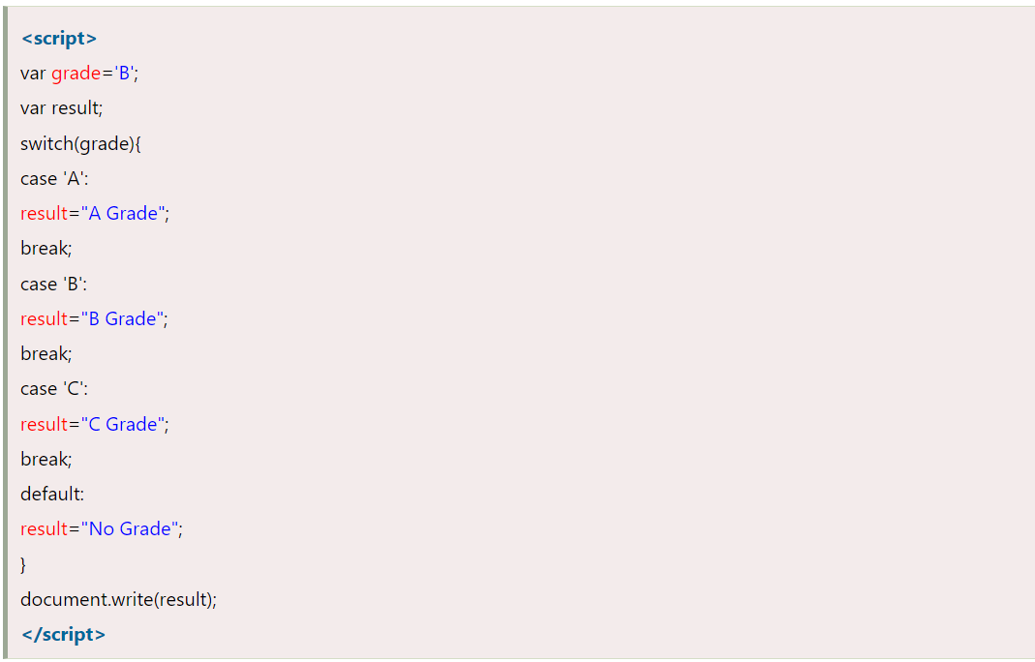
JavaScript Switch

Slide 26
JavaScript Loops
The JavaScript loops are used to iterate the piece of code using for, while, do while or for-in loops. It makes the code compact. It is mostly used in array.
There are four types of loops in JavaScript.
for loop
while loop
do-while loop
for-in loop

Slide 27
JavaScript For loop
The JavaScript for loop iterates the elements for the fixed number of times.
It should be used if number of iteration is known. The syntax of for loop is given below.
for (initialization; condition; increment)
{
code to be executed
}

Slide 28
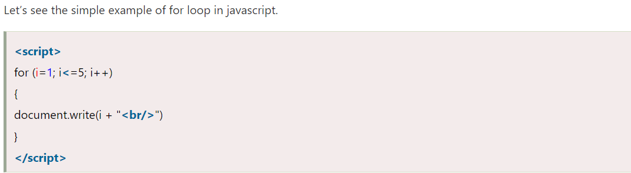
JavaScript For loop

Slide 29
JavaScript while loop
The JavaScript while loop iterates the elements for the infinite number of times.
It should be used if number of iteration is not known. The syntax of while loop is given below.
while (condition)
{
code to be executed
}

Slide 30
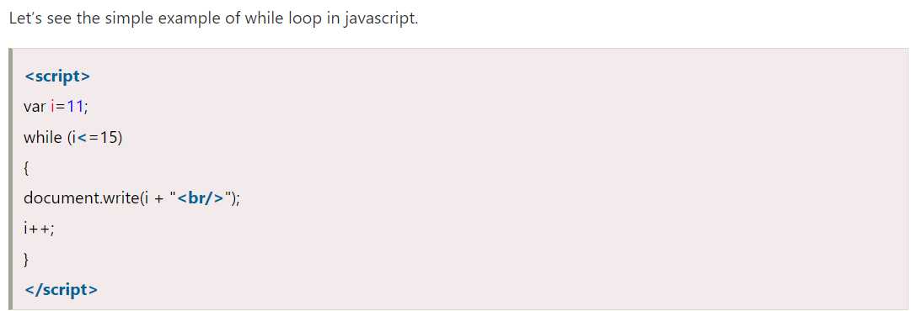
JavaScript while loop

Slide 31
JavaScript Functions
JavaScript functions are used to perform operations. We can call JavaScript function many times to reuse the code.
There are mainly two advantages of JavaScript functions.
Code reusability: We can call a function several times so it save coding.
Less coding: It makes our program compact. We don’t need to write many lines of code each time to perform a common task.
The syntax of declaring function is given below.
function functionName([arg1, arg2, ...argN]){
//code to be executed
}

Slide 32
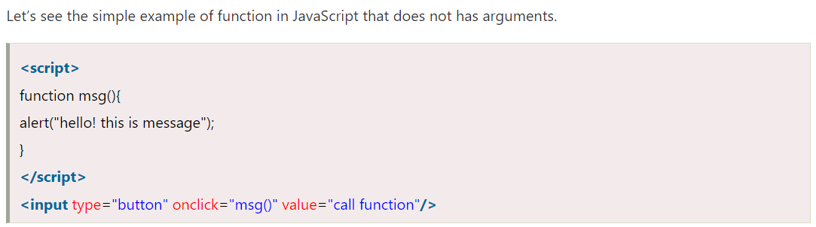
JavaScript Function Example

Slide 33
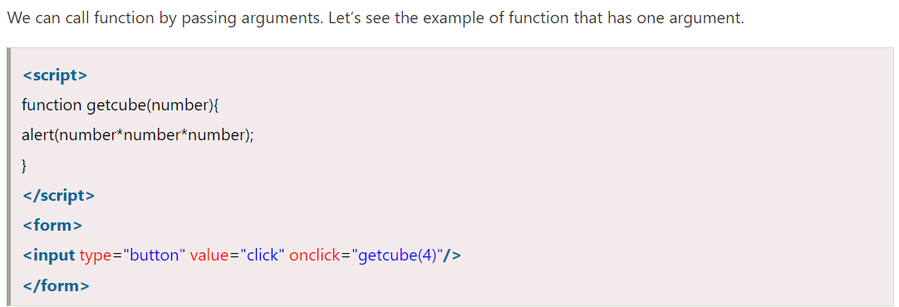
JavaScript Function Arguments

Slide 34
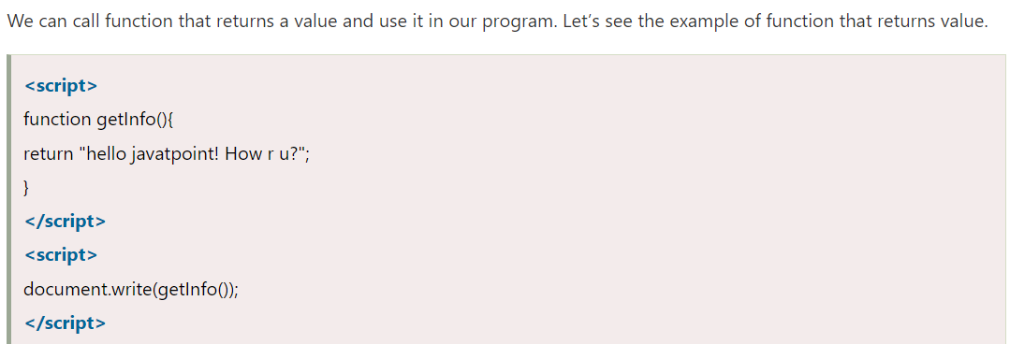
Function with Return Value

Slide 35
JavaScript Function Object
In JavaScript, the purpose of Function constructor is to create a new Function object.
It executes the code globally. However, if we call the constructor directly, a function is created dynamically but in an unsecured way.
Syntax
new Function ([arg1[, arg2[, ....argn]],] functionBody)

Slide 36
Parameter
arg1, arg2, .... , argn - It represents the argument used by function.
functionBody - It represents the function definition.

Slide 37
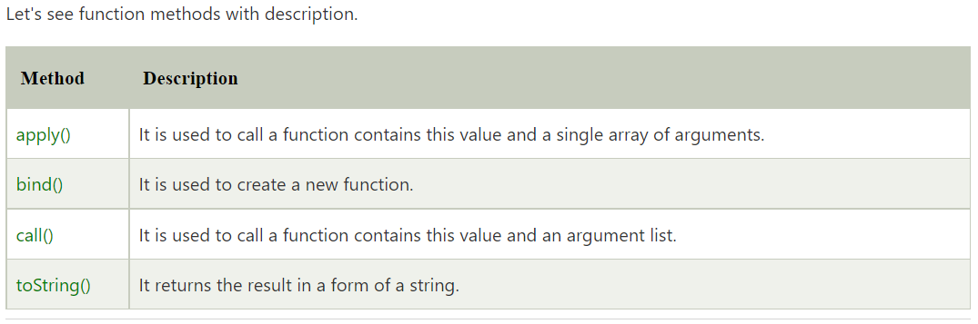
JavaScript Function Methods

Slide 38
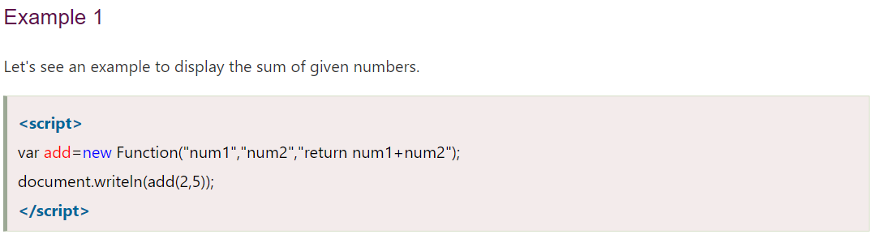
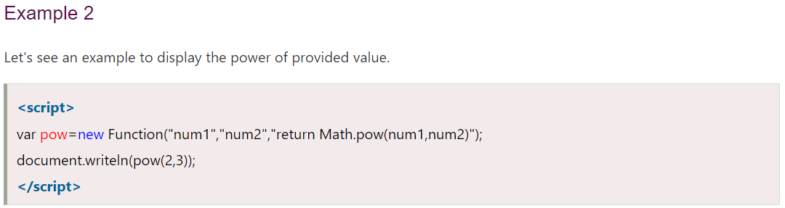
JavaScript Function Object Examples

Slide 39
JavaScript Objects
A JavaScript object is an entity having state and behavior (properties and method). For example: car, pen, bike, chair, glass, keyboard, monitor etc.
JavaScript is an object-based language. Everything is an object in JavaScript.
JavaScript is template based not class based. Here, we don't create class to get the object. But, we direct create objects.

Slide 40
Creating Objects in JavaScript
There are 3 ways to create objects.
By object literal
By creating instance of Object directly (using new keyword)
By using an object constructor (using new keyword)

Slide 41
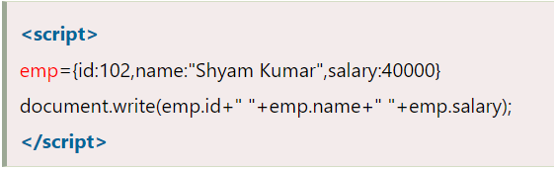
JavaScript Object by object literal
The syntax of creating object using object literal is given below:
object={property1:value1,property2:value2.....propertyN:valueN}
As you can see, property and value is separated by : (colon).
Let’s see the simple example of creating object in JavaScript.

Slide 42
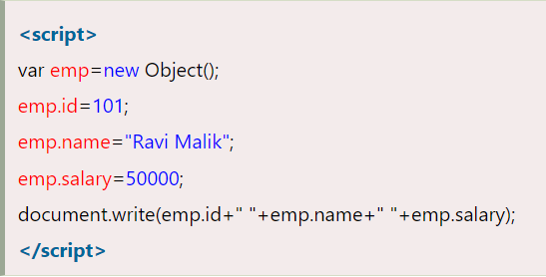
By creating instance of Object
The syntax of creating object directly is given below:
var objectname=new Object();
Here, new keyword is used to create object.
Let’s see the example of creating object directly.

Slide 43
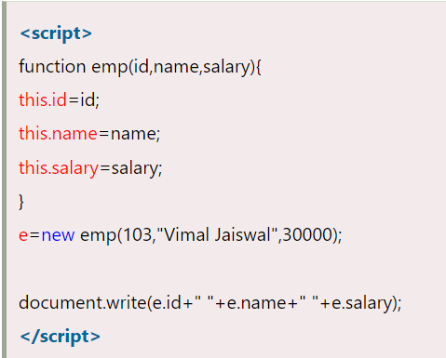
By using an Object constructor
Here, you need to create function with arguments. Each argument value can be assigned in the current object by using this keyword.
The this keyword refers to the current object.
The example of creating object by object constructor is given below.

Slide 44
JavaScript Arrays
JavaScript array is an object that represents a collection of similar type of elements.
There are 3 ways to construct array in JavaScript
By array literal
By creating instance of Array directly (using new keyword)
By using an Array constructor (using new keyword)

Slide 45
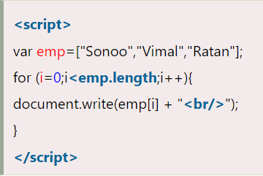
JavaScript array literal
The syntax of creating array using array literal is given below:
var arrayname=[value1,value2.....valueN];
As you can see, values are contained inside [ ] and separated by , (comma).
Let's see the simple example of creating and using array in JavaScript.

Slide 46
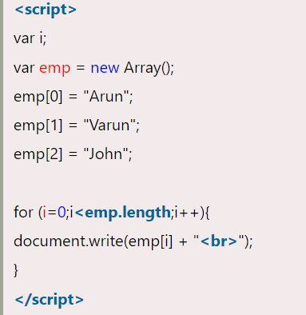
JavaScript Array directly (new keyword)
The syntax of creating array directly is given below:
var arrayname=new Array();
Here, new keyword is used to create instance of array.
Let's see the example of creating array directly.

Slide 47
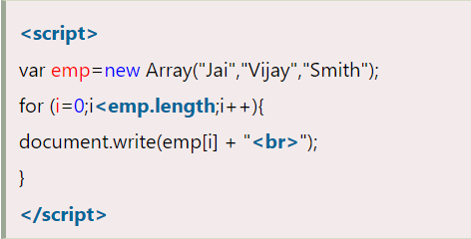
JavaScript array constructor (new keyword)
Here, you need to create instance of array by passing arguments in constructor so that we don't have to provide value explicitly.
The example of creating object by array constructor is given below.

Slide 48
JavaScript String
The JavaScript string is an object that represents a sequence of characters.
There are 2 ways to create string in JavaScript
By string literal
By string object (using new keyword)

Slide 49
By string literal
The string literal is created using double quotes. The syntax of creating string using string literal is given below:
var stringname="string value";
Let's see the simple example of creating string literal.
<script>
var str="This is string literal";
document.write(str);
</script>

Slide 50
By string object (using new keyword)
The syntax of creating string object using new keyword is given below:
var stringname=new String("string literal");
Here, new keyword is used to create instance of string.
Let's see the example of creating string in JavaScript by new keyword.
<script>
var stringname=new String("hello javascript string");
document.write(stringname);
</script>

Slide 51
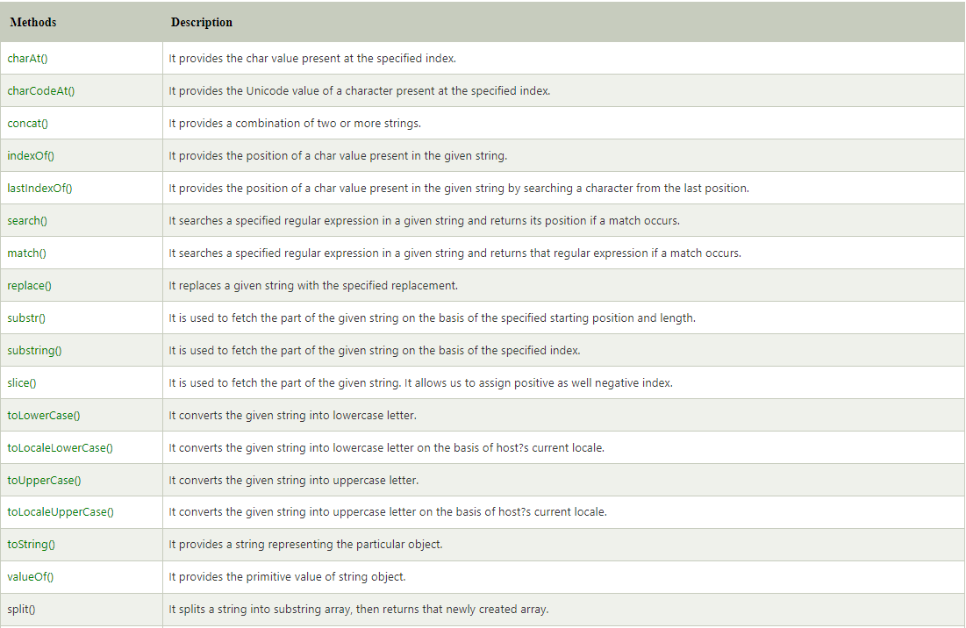
JavaScript String Methods

Slide 52
JavaScript Date Object
The JavaScript date object can be used to get year, month and day. You can display a timer on the webpage by the help of JavaScript date object.
You can use different Date constructors to create date object. It provides methods to get and set day, month, year, hour, minute and seconds.

Slide 53
Date Constructor
You can use 4 variant of Date constructor to create date object.
Date()
Date(milliseconds)
Date(dateString)
Date(year, month, day, hours, minutes, seconds, milliseconds)

Slide 54
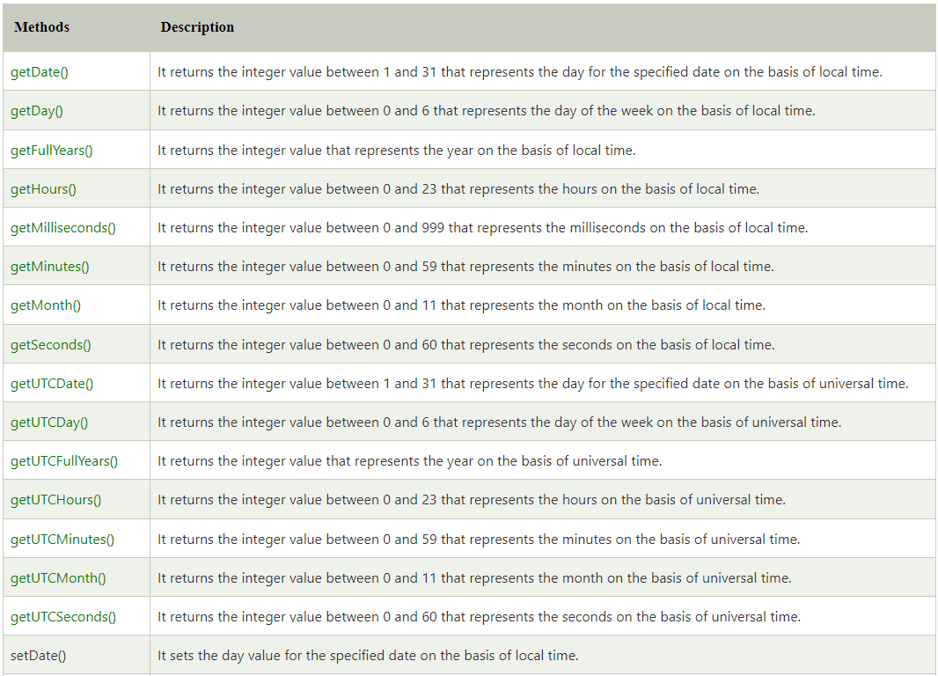
JavaScript Date Methods

Slide 55
JavaScript Date Example
Let's see the simple example to print date object. It prints date and time both.
Current Date and Time: <span id="txt"></span>
<script>
var today=new Date();
document.getElementById('txt').innerHTML=today;
</script>

Slide 56
JavaScript Date Example
Let's see another code to print date/month/year.
<script>
var date=new Date();
var day=date.getDate();
var month=date.getMonth()+1;
var year=date.getFullYear();
document.write("<br>Date is: "+day+"/"+month+"/"+year);
</script>
Output:
Date is: 7/4/2022

Slide 57
JavaScript Current Time Example
Let's see the simple example to print current time of system.
Current Time: <span id="txt"></span>
<script>
var today=new Date();
var h=today.getHours();
var m=today.getMinutes();
var s=today.getSeconds();
document.getElementById('txt').innerHTML=h+":"+m+":"+s;
</script>

Slide 58
JavaScript Digital Clock Example
Let's see the simple example to display digital clock using JavaScript date object.
There are two ways to set interval in JavaScript: by setTimeout() or setInterval() method.
Current Time: <span id="txt"></span>
<script>
window.onload=function(){ getTime(); }
function getTime(){
var today=new Date();
var h=today.getHours();
var m=today.getMinutes();
var s=today.getSeconds();
// add a zero in front of numbers<10
m=checkTime(m);
s=checkTime(s);
document.getElementById('txt').innerHTML=h+":"+m+":"+s;
setTimeout(function(){getTime()},1000);
}
//setInterval("getTime()",1000);//another way
function checkTime(i){
if (i<10){
i="0" + i;
}
return i;
}
</script>

Slide 59
Browser Object Model (BOM)
The Browser Object Model (BOM) is used to interact with the browser.
The default object of browser is window means you can call all the functions of window by specifying window or directly. For example:
window.alert("hello javatpoint");
is same as:
alert("hello javatpoint");
You can use a lot of properties (other objects) defined underneath the window object like document, history, screen, navigator, location, innerHeight, innerWidth,

Slide 60
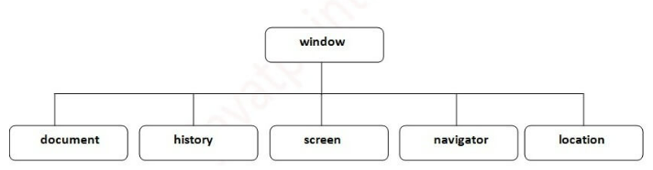
Browser Object Model (BOM)

Slide 61
Window Object
The window object represents a window in browser. An object of window is created automatically by the browser.
Window is the object of browser, it is not the object of javascript. The javascript objects are string, array, date etc.
The important methods of window object are as follows:
alert() displays the alert box containing message with ok button.
confirm() displays the confirm dialog box containing message with ok and cancel button.
prompt() displays a dialog box to get input from the user.
open() opens the new window.
close() closes the current window.
setTimeout() performs action after specified time like calling function, evaluating expressions etc.

Slide 62
Example of open() in javascript
It displays the content in a new window.
<script type="text/javascript">
function msg(){
open("http://www.javatpoint.com");
}
</script>
<input type="button" value="javatpoint" onclick="msg()"/>

Slide 63
Example of setTimeout() in javascript
It performs its task after the given milliseconds.
<script type="text/javascript">
function msg(){
setTimeout(
function(){
alert("Welcome to Javatpoint after 2 seconds")
},2000);
}
</script>
<input type="button" value="click" onclick="msg()"/>

Slide 64
JavaScript History Object
The JavaScript history object represents an array of URLs visited by the user.
By using this object, you can load previous, forward or any particular page.
The history object is the window property, so it can be accessed by:
window.history
Or,
history

Slide 65
Property of JavaScript history object
There are only 1 property of history object.
Property Description
length returns the length of the history URLs.
There are only 3 methods of history object.
Method Description
forward() loads the next page.
back() loads the previous page.
go() loads the given page number.

Slide 66
Example of history object
Let’s see the different usage of history object.
history.back();//for previous page
history.forward();//for next page
history.go(2);//for next 2nd page
history.go(-2);//for previous 2nd page

Slide 67
JavaScript Navigator Object
The JavaScript navigator object is used for browser detection. It can be used to get browser information such as appName, appCodeName, userAgent etc.
The navigator object is the window property, so it can be accessed by:
window.navigator
Or,
navigator

Slide 68
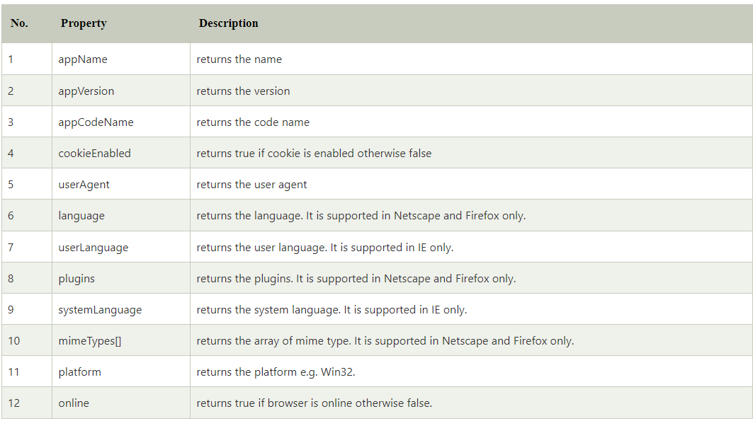
Properties of Navigator

Slide 69
Methods of JavaScript navigator object
The methods of navigator object are given below.
Method Description
javaEnabled() checks if java is enabled.
taintEnabled() checks if taint is enabled. It is deprecated since JavaScript 1.2.

Slide 70
Example of navigator object
Let’s see the different usage of history object.
<script>
document.writeln("<br/>navigator.appCodeName: "+navigator.appCodeName);
document.writeln("<br/>navigator.appName: "+navigator.appName);
document.writeln("<br/>navigator.appVersion: "+navigator.appVersion);
document.writeln("<br/>navigator.cookieEnabled: "+navigator.cookieEnabled);
document.writeln("<br/>navigator.language: "+navigator.language);
document.writeln("<br/>navigator.userAgent: "+navigator.userAgent);
document.writeln("<br/>navigator.platform: "+navigator.platform);
document.writeln("<br/>navigator.onLine: "+navigator.onLine);
</script>

Slide 71
JavaScript Screen Object
The JavaScript screen object holds information of browser screen. It can be used to display screen width, height, colorDepth, pixelDepth etc.
The screen object is the window property, so it can be accessed by:
window.screen
Or,
screen

Slide 72
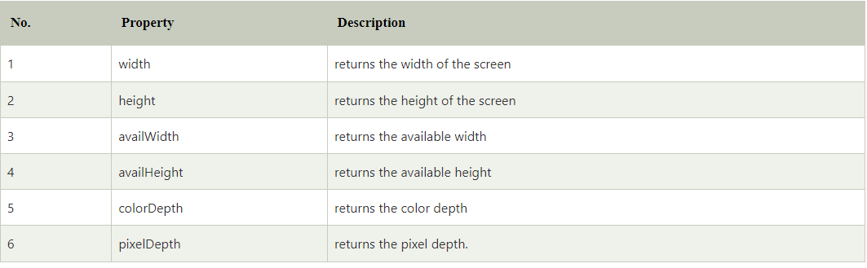
Properties of screen object

Slide 73
Example of JavaScript Screen Object
Let’s see the different usage of screen object.
<script>
document.writeln("<br/>screen.width: "+screen.width);
document.writeln("<br/>screen.height: "+screen.height);
document.writeln("<br/>screen.availWidth: "+screen.availWidth);
document.writeln("<br/>screen.availHeight: "+screen.availHeight);
document.writeln("<br/>screen.colorDepth: "+screen.colorDepth);
document.writeln("<br/>screen.pixelDepth: "+screen.pixelDepth);
</script>

Slide 74
Document Object Model
When html document is loaded in the browser, it becomes a document object. It is the root element that represents the html document. It has properties and methods. By the help of document object, we can add dynamic content to our web page.
As mentioned earlier, it is the object of window. So
window.document
Is same as
document
According to W3C - "The W3C Document Object Model (DOM) is a platform and language-neutral interface that allows programs and scripts to dynamically access and update the content, structure, and style of a document."

Slide 75
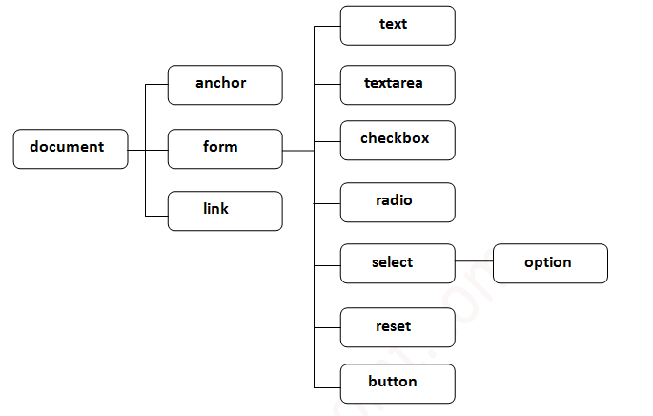
Properties of DOM

Slide 76
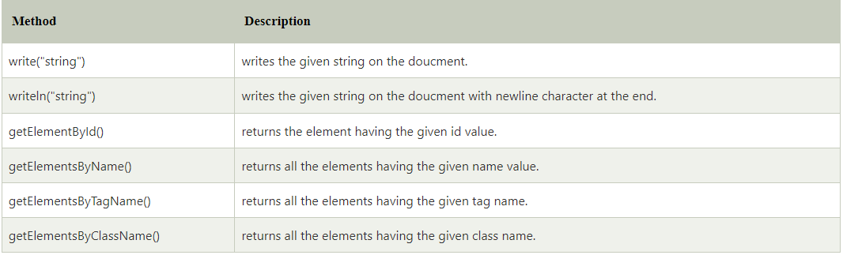
Methods of document object

Slide 77
Accessing field value by document object
In this example, we are going to get the value of input text by user. Here, we are using document.form1.name.value to get the value of name field.
Here, document is the root element that represents the html document.
form1 is the name of the form.
name is the attribute name of the input text.
value is the property, that returns the value of the input text.
Let's see the simple example of document object that prints name with welcome message.

Slide 78
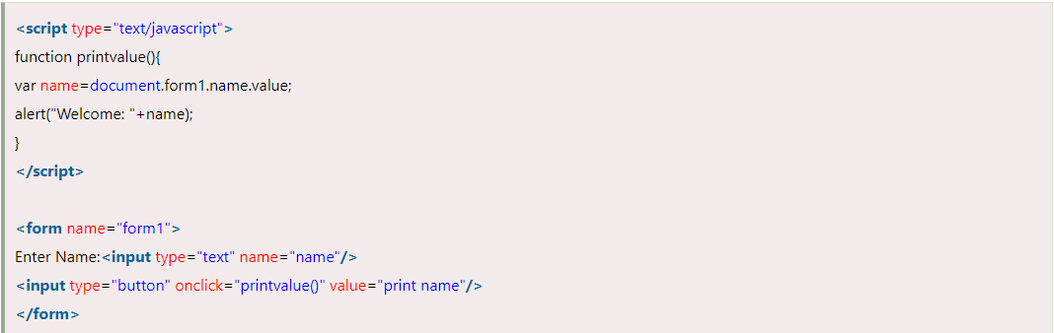
Example

Slide 79
Javascript - document.getElementById() method
The document.getElementById() method returns the element of specified id.
In the previous page, we have used document.form1.name.value to get the value of the input value. Instead of this, we can use document.getElementById() method to get value of the input text. But we need to define id for the input field.
Let's see the simple example of document.getElementById() method that prints cube of the given number.

Slide 80
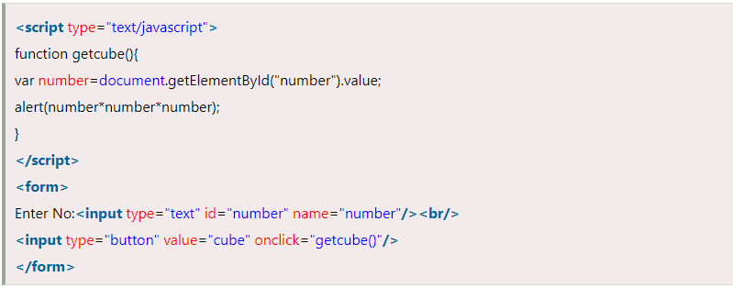
Example

Slide 81
Javascript - document.getElementsByName() method
The document.getElementsByName() method returns all the element of specified name.
The syntax of the getElementsByName() method is given below:
document.getElementsByName("name")
Here, name is required.
Example of document.getElementsByName() method
In this example, we going to count total number of genders. Here, we are using getElementsByName() method to get all the genders.

Slide 82
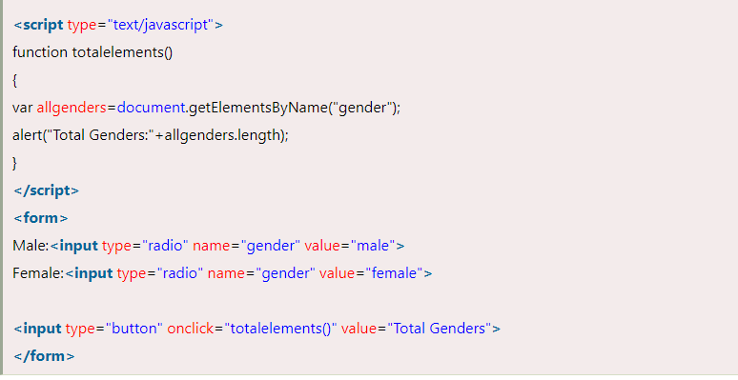
Example

Slide 83
Javascript - document.getElementsByTagName() method
The document.getElementsByTagName() method returns all the element of specified tag name.
The syntax of the getElementsByTagName() method is given below:
document.getElementsByTagName("name")
Here, name is required.
Example of document.getElementsByTagName() method
In this example, we going to count total number of paragraphs used in the document. To do this, we have called the document.getElementsByTagName("p") method that returns the total paragraphs.

Slide 84
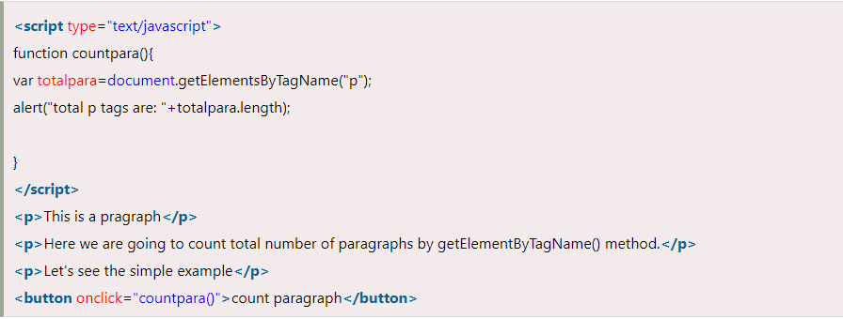
Example

Slide 85
Javascript - innerHTML
The innerHTML property can be used to write the dynamic html on the html document.
It is used mostly in the web pages to generate the dynamic html such as registration form, comment form, links etc.
In this example, we are going to create the html form when user clicks on the button.
In this example, we are dynamically writing the html form inside the div name having the id mylocation. We are identifing this position by calling the document.getElementById() method.

Slide 86
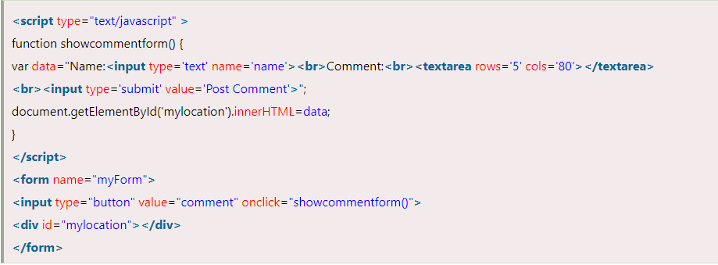
Example

Slide 87
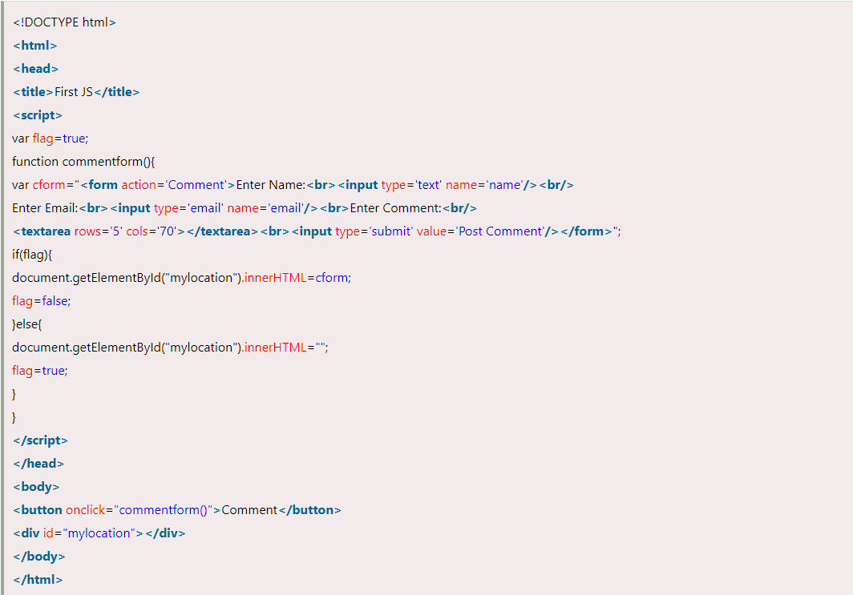
Show/Hide Comment Form Example using innerHTML

Slide 88
JavaScript - innerText
The innerText property can be used to write the dynamic text on the html document. Here, text will not be interpreted as html text but a normal text.
It is used mostly in the web pages to generate the dynamic content such as writing the validation message, password strength etc.
In this example, we are going to display the password strength when releases the key after press.

Slide 89
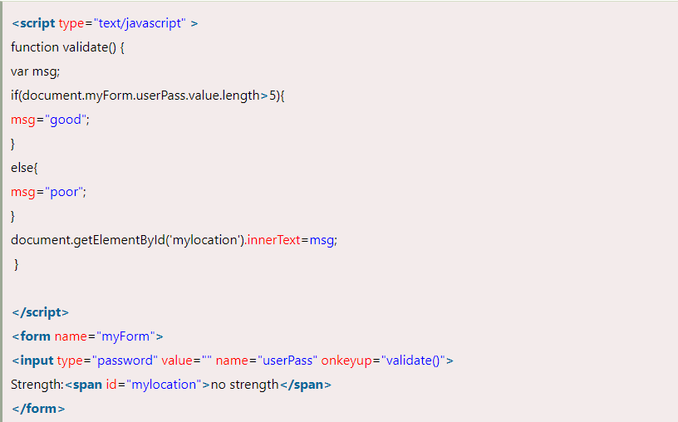
JavaScript innerText Example

Slide 90
JavaScript Form Validation
It is important to validate the form submitted by the user because it can have inappropriate values. So, validation is must to authenticate user.
JavaScript provides facility to validate the form on the client-side so data processing will be faster than server-side validation. Most of the web developers prefer JavaScript form validation.
Through JavaScript, we can validate name, password, email, date, mobile numbers and more fields.

Slide 91
JavaScript Form Validation Example
In this example, we are going to validate the name and password. The name can’t be empty and password can’t be less than 6 characters long.
Here, we are validating the form on form submit. The user will not be forwarded to the next page until given values are correct.

Slide 92
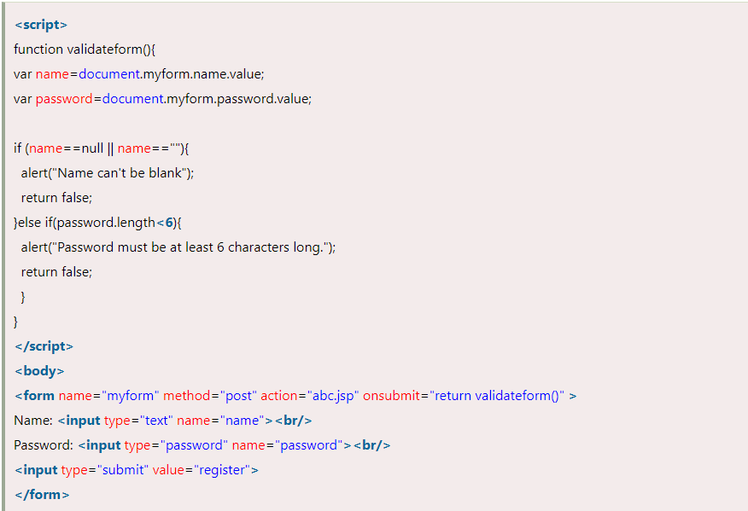
Example

Slide 93
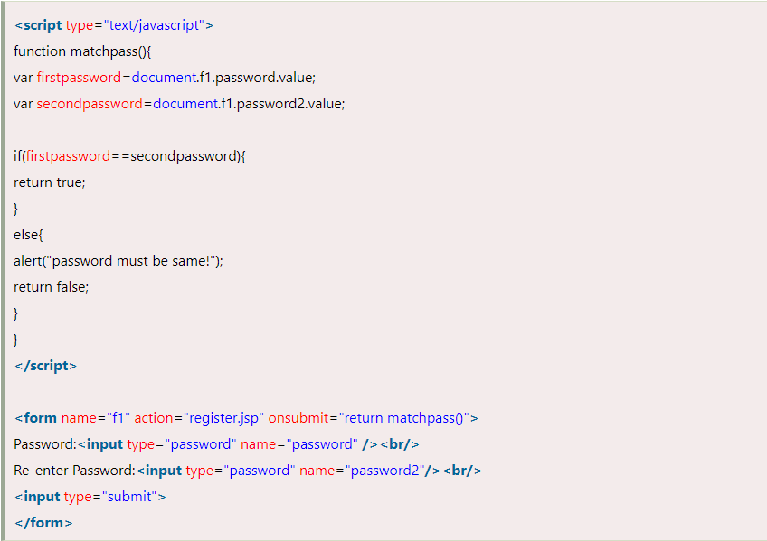
JavaScript Retype Password Validation

